Slide 1


Smart Classroom Monitoring System
MIT College of Railway Engineering and Research, Barshi
Group No : 24
Guide: Prof. Niranjan Patil
Team Members:
Shraddha Ukirade
Anzalna Tamboli
Jyoti Baravkar
Gayatri Bole

Slide 2








Index
This presentation outlines our interdisciplinary project on developing an innovative classroom monitoring system.
Motivation
Introduction
Literature Survey & Objectives
Methods & Materials
Experimental Setup
System Flow Chart
Progress Made
Conclusion & References

Slide 3
Motivation: Enhancing Classroom Engagement
This project is motivated by the desire to provide educators with an objective, real-time tool to observe student engagement. Traditional classroom teaching faces challenges in ensuring that students remain attentive engage during lectures. Teachers cannot track individual engagement in large classrooms. Students often get distracted (mobiles, side talks, drowsiness).
Subjective Observation
Teachers often struggle to monitor every student's attention level simultaneously, leading to potential biases or missed cues.
Lag in Intervention
By the time a teacher identifies a disengaged student, valuable learning moments may have already passed.
Passive Learning
This reduces attention, lowers retention of knowledge, and creates a gap between teaching and actual understanding.
Addressing these challenges can lead to more dynamic, responsive, and ultimately more effective teaching environments, benefiting both instructors and students.

Slide 4
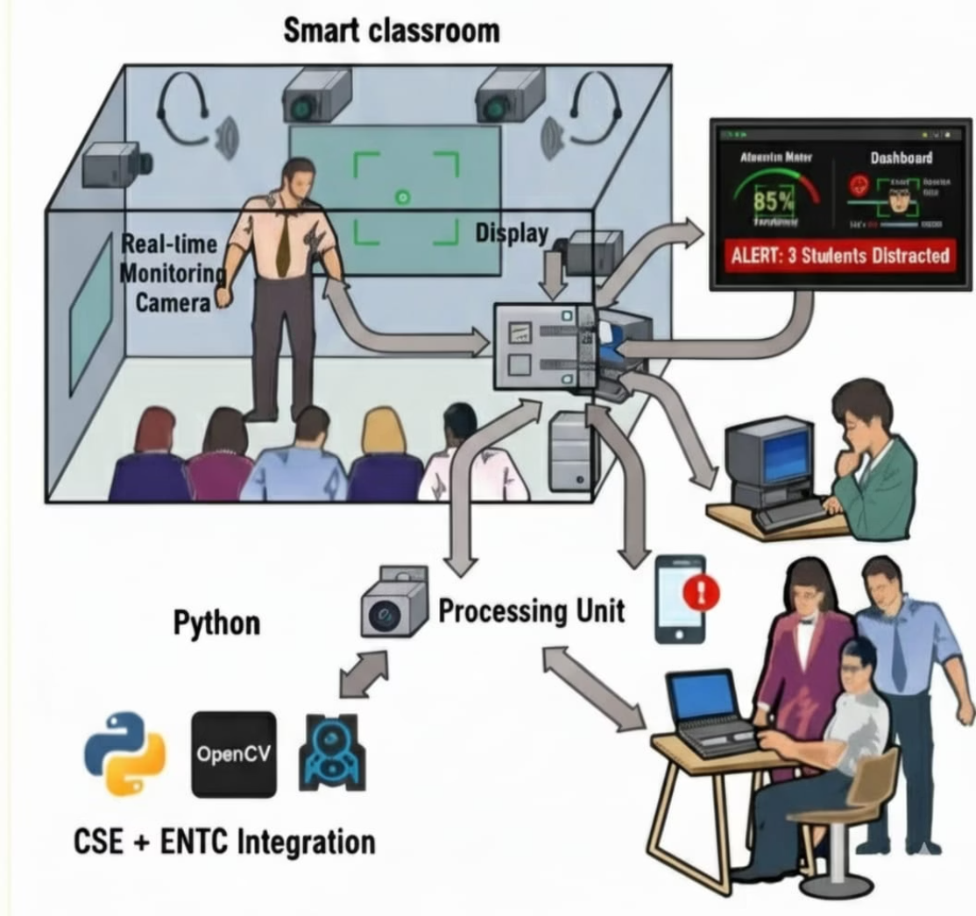


Introduction to the Smart Classroom Monitoring System
The core principle involves capturing student video feeds and processing them to extract head-pose, eye gaze data to reflect a student's attention level. This data is then interpreted to infer attention. When disengagement is detected, the system triggers alerts, offering a proactive approach to classroom management.
CSE Contribution
Development of robust computer vision algorithms for real-time head-pose & face orientation detection and attention inference. Includes data logging and dashboard creation.
ENTC Contribution
Hardware integration, sensor interfacing (LEDs, Notification), power management, and ensuring signal integrity to avoid electromagnetic interference.
This integration results in a complete system capable of both intelligent analysis and tangible, immediate feedback within the classroom.

Slide 5
Literature Survey & Project Objectives
Existing research in student attention detection often relies on intrusive sensors, expensive hardware, or complex deep learning models requiring significant computational resources. While some studies explore head-pose estimation, few provide a holistic, real-time, and low-cost solution with immediate physical feedback for the teacher.
Das, R.Dev, S. (2025): Optimizing student engagement detection using facial and behavioral features
Naveen A.; JaccMandava A. (2025) :Detection of Student Engagement Feature via emotion recognition.
Gaps in Current Literature:
Project Objectives:
Lack of low-cost, real-time integrated solutions.
Develop a real-time monitoring system using Raspberry Pi and a camera module.
Reliance on high-end computing resources (e.g., cloud AI servers).
To minimize manual monitoring (Human-work)
Design and integrate an Arduino-based physical alert system (LED/Notification).
Limited practical, lack of monitoring and feedback.
Research often focuses on performance outcomes, not classroom engagement
To support adaptive teaching methods by identifying when and where students lose focus.

Slide 6
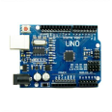
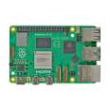
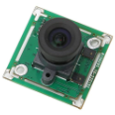
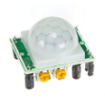
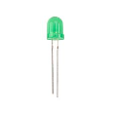

Methods and Materials Required
The successful implementation of our Classroom Monitoring System hinges on a carefully selected set of hardware components and a robust software methodology. The design emphasizes affordability and ease of deployment, utilizing readily available components while ensuring high performance for attention detection.
Hardware Components:
Software Methodology:
Programming Languages:
Arduino Uno : Dedicated for handling immediate physical alerts, receiving commands and controlling LEDs. Ensures isolated, reliable outputs.
Python + OpenCV : Powerful tool for real-time monitoring video analysis.
C++ (Arduino IDE): programming microcontroller to listen for serial commands and control outputs.
Raspberry Pi 4 Model B: The central processing unit for running computer vision algorithms and managing the system.
2. Libraries:
OpenCV: For real-time image processing, facial detection, and head-pose
estimation.
Camera module: Captures the live video feed and face
orientations
PySerial: For serial communication between Raspberry Pi and Arduino.
PIR Sensor: Detects the motion by monitoring the changes
in infrared radiations levels caused by warm objects
3. Attention Detection Algorithm:
Utilizes techniques like facial landmark detection to track key points on the face.
LED: Output indicators for attention alerts for educators
Deviations from a front-facing pose indicate potential distraction.
4. Data Logging & Dashboard:
Resistors: Protecting LEDs from excessive current
Potentially visualized through a basic web-based dashboard accessible to
the teacher.
This combination of hardware and software forms the foundation of our robust and integrated classroom monitoring solution.

Slide 7
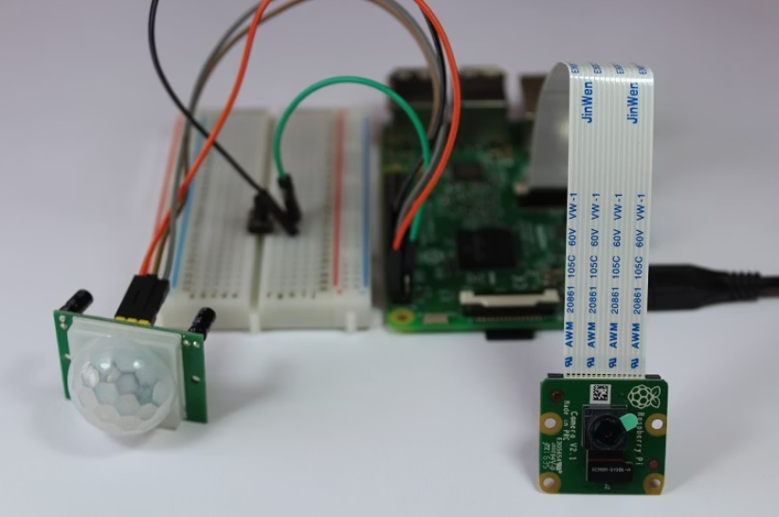
Experimental/Simulation Setup
The system's effectiveness relies heavily on its physical deployment and the careful configuration of its components. Our experimental setup ensures optimal data capture and reliable operation within a realistic classroom environment.
Physical Setup & Integration :
Arduino Integration:
Connectivity: Raspberry Pi communicates with Arduino via USB serial interface.
Command Protocol: Pi sends single-byte commands (‘A’- Attentive, ‘N’-Not attentive)
to Arduino.
Arduino : Firmware on Arduino listens on the serial port, parses 'A'/'N' commands, and toggles LED/Notification accordingly.
Wiring:
LED: Anode connected to a digital pin via a 220Ω current-limiting resistor; cathode
connected to GND.
Camera: The camera is connected to the Raspberry Pi board through the CSI (Camera Serial Interface) port for image and video capture.
Power & EMI Considerations:
Power Regulators: Essential for providing stable and clean power. Separate voltage regulators are used for the Raspberry Pi and the Arduino to prevent voltage drops or power fluctuations from affecting sensitive components.
Grounding: Proper grounding techniques are employed to minimize ground loops and ensure a stable reference voltage across the
system.
This comprehensive setup ensures that both the hardware and software components work in harmony to deliver accurate and reliable
attention monitoring.

Slide 8
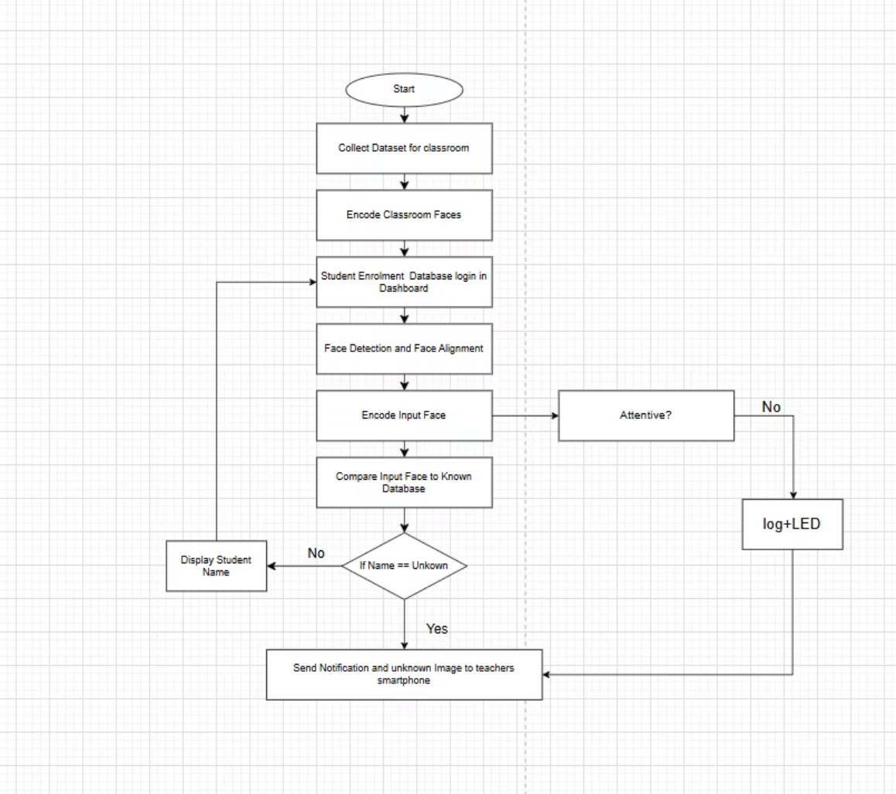
System Workflow and Data Processing
The Classroom Monitoring System follows a clear, sequential process to detect student attention and provide immediate feedback. This workflow integrates the CSE-developed computer vision aspects with the ENTC-engineered hardware alerts, creating a cohesive and responsive system.
This streamlined process ensures timely detection and actionable feedback, empowering teachers to manage classroom dynamics effectively.
Flowchart:
Process:
Initialize Camera and Sensor.
Check PIR Sensor: Is motion detected?
If No, loop.
If Yes, proceed.
Capture real-time video from camera and Face Detection Use OpenCV to
detect faces in the image.
4. Face Recognition: Compare detected faces with pre-registered student
faces in the database.
5. Decision If: ·
Recognized: Check its attentivity, if No then a notification will send to its respective teachers and parents via Dashboard.
Unrecognized: Trigger an "Intrusion Alert" to the teachers.
6. Update Database with results.
7. Display Results on the dashboard.

Slide 9
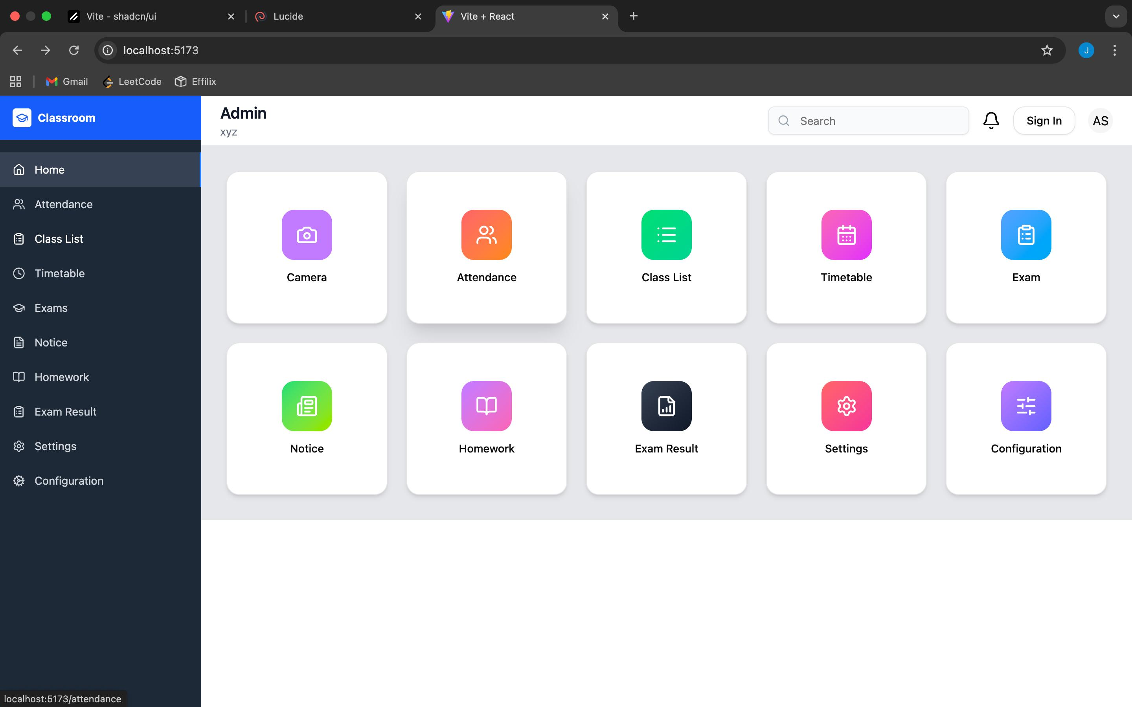
Progress Made Till Now
Our project has advanced significantly, demonstrating the feasibility and initial effectiveness of the integrated classroom monitoring system. We have successfully implemented key components from the CSE domains.
CSE Achievements
Progress
✅Literature Survey Completed: Researched and analyzed existing methods for facial recognition and hardware integration.
✅ Software Tools Installed: Set up the necessary programming environment (Python, OpenCV libraries) on our development systems.
✅Hardware Architecture: Finalized the component list and connection diagram for the Raspberry Pi, camera, and sensors.
✅ Component Research: Researched and identified the exact models for all required hardware (Raspberry Pi 4, Pi Camera, PIR sensor).
Future Implementation:
⏳ Hardware Assembly and Interfacing
System Design Finalized: Designed the complete workflow for face detection, recognition, and alert generation.
⏳ Coding the Core Detection & Recognition Logic
⏳ Dashboard Backend and Frontend Development
Dashboard Wireframe: Designed the layout and user interface for the web monitoring dashboard.
⏳ System Integration and Testing
These foundational achievements lay a strong groundwork for the final integration and comprehensive testing of the complete classroom monitoring system.

Slide 10
Conclusion and Future Work
Our interdisciplinary Classroom Monitoring System successfully addresses the need for real-time, objective student attention detection. By effectively integrating CSE's computer vision prowess with ENTC's hardware components, we have developed a low-cost, non-intrusive solution that offers tangible value to educators.
Real-time Monitoring
Low-cost Setup
Interdisciplinary Integration
Teachers instantly know which students are attentive, enabling proactive intervention.
Utilizes affordable components like Raspberry Pi and webcam, avoiding expensive AI servers.
A successful fusion of hardware (ENTC) and software (CSE) for a holistic solution.
Future Enhancements:
Develop a more sophisticated web-based dashboard with historical trend analysis and per-student reporting.
Explore advanced head-pose estimation models for improved accuracy and robustness to variations in student appearance.
Expand the alert system to include varied feedback mechanisms or adaptive responses based on sustained disengagement.
References:
Ali et al. (2025). "AI-Based Classroom Monitoring System."
Patil et al. (2024). "IoT Based Class Monitoring System with Smart Attendance."
Patel, A., & Sharma, R. (2023). Arduino-based alert systems for classroom management. Proceedings of the Electrical and Computer Engineering
Symposium, 45-50.
Smith, J. (2022). Real-time student engagement detection in educational environments. Journal of Educational Technology Research, 15(3), 123-145.
Chen, L., & Wang, Q. (2021). Head-pose estimation for attention analysis using lightweight computer vision models. International Conference on
Robotics and Automation, 87-92.

